Slide 1



The Trader Desktop Redesigned
May 2013
Notes:
© 2013 Accenture, Avanade, Microsoft. All Rights Reserved.
Internal Walking Deck for Accenture-Avanade-Microsoft Use.

Slide 2





Delivering value straight to your key stakeholders

Slide 3
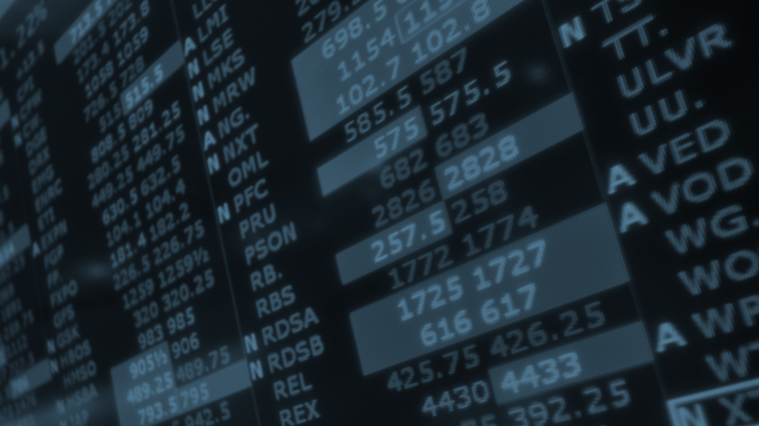

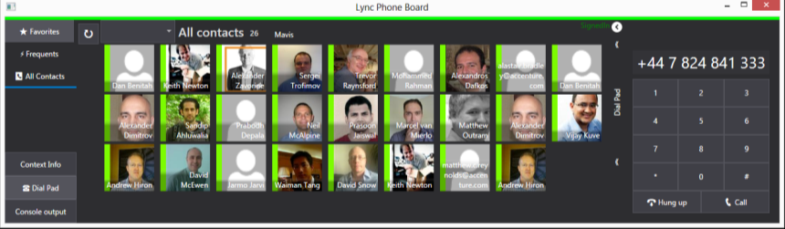
Value for stakeholders: The software solution
Integrated Communications

Slide 4



Value for stakeholders: The software solution
Integrated Communications
Speed & efficiency when talking with colleagues & clients
Improved customer relationships through face-to-face contact
Stronger collaboration with team
No dealer board = reduced IT procurement and support costs

Slide 5

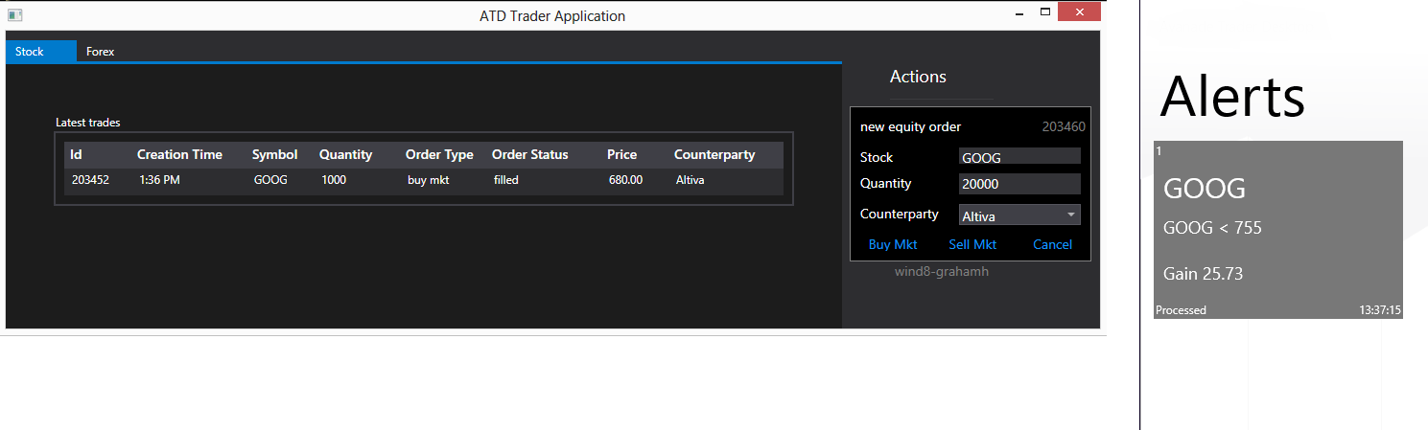
Value for stakeholders: The software solution
Context sharing & alerts

Slide 6
Value for stakeholders: The software solution
Context sharing & alerts
Eradication of multiple inputs = increased efficiency and reduced risk
Reduced reconciliation overhead
Enhanced alerts utility
Eradication of multiple inputs = increased efficiency and reduced risk

Slide 7

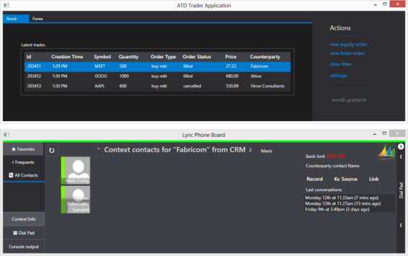
Value for stakeholders: The software solution
Integrated CRM

Slide 8
Value for stakeholders: The software solution
Integrated CRM
Integrated CRM = Speed & efficiency through immediate access to customer data
Enhanced context and decision making efficiency through instant availability of customer history
Less reliance on individual trader relationship through increased corporate relationship history knowledge
Improved customer service and retention

Slide 9
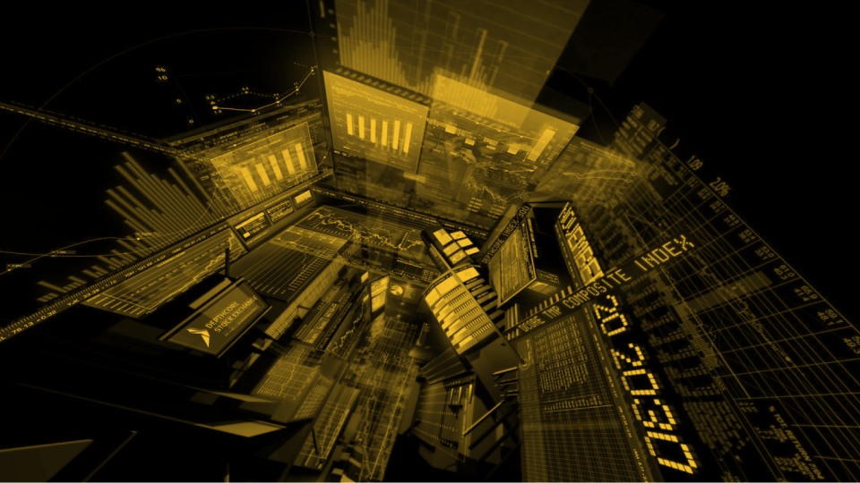

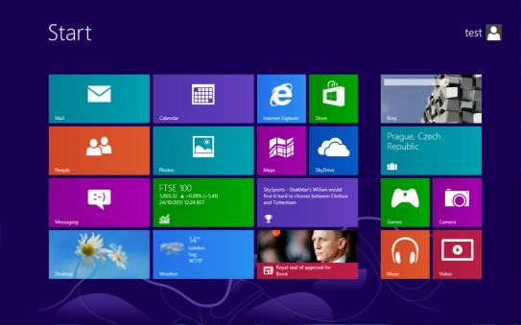
Value for stakeholders: The software solution
User Interface

Slide 10
Value for stakeholders: The software solution
User Interface
Swifter application access
Consolidated OS across trading floor, desktop laptop and tablet
Reduced screens result in simpler data access
Consolidated OS = reduction of service management investment
Reduced monitor procurement and support costs through consolidation
Reduced app dev cost

Slide 11
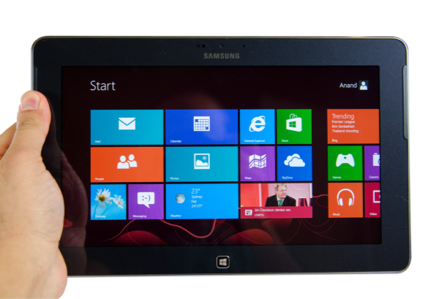
Value For Stakeholders – Infrastructure
Remote Capability

Slide 12
Value For Stakeholders – Infrastructure
Remote Capability
Ability to access information and execute trades whilst away from desk
Up to the minute info at all times
Information updates whilst out of office
Stronger team collaboration through immediate contact
Instant position knowledge when away from desk

Slide 13
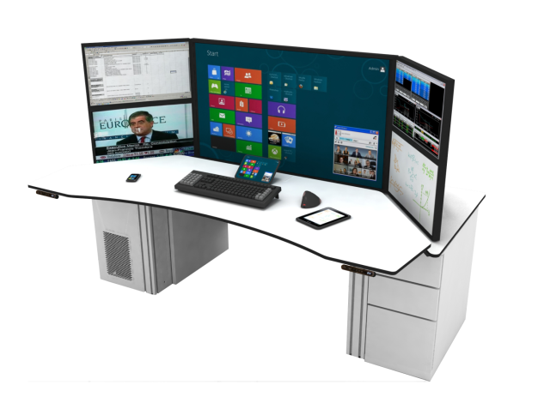
Value For Stakeholders – Infrastructure

Slide 14




Value For Stakeholders – Infrastructure
Latest Screen & Desk Technology
Greater comfort resulting in increased productivity
Engagement and staff retention
Reduced power bills
Reduces infrastructure costs i.e reduced cable mgmt
Perception of IT as an ally
Enhanced environmental screen features
Latest ergonomics features
Increased corporate perception & reduced reputational risk

Slide 15
Summary
 | Trader | Head Of Desk | CIO | CFO | HR
Integrated comms
Enhanced context sharing
Alerts & Notifications
Integrated CRM
Windows 8 OS
Remote Working Capability
Environmental Features
Improved Ergonomics

Slide 16




Next Step
Arrange a meeting with your contact to discuss how the ideas showcased in the Trader Desktop Redesigned project can help your company create competitive edge, minimise risk, reduce cost and improve colleague engagement.
Ian Shanahan
Alliance Relationship Director
Ian.d.shanahan @accenture.com
+44 7818001669
Bruce McKee
Industry Market Development Mgr
Bruce.mckee @microsoft.com
+44 7764359661
Mark Corley
UKI CTO
Mark.corley @avanade.com
+44 7870160389
Martyn Bullock
Finance & Professional Services Business Mgr
m.Bullock @samsung.com
+ 44 7918 697204
David Shrigley
Sales Director
dshrigley@technologydesking.com
+44 7917850833

Slide 17
声明：
所有的版权属于原有公司，文件均来自公开渠道
此文件仅供学习使用，任何人不得进行以此为商业目的的行为
如有疑问，请立即删除
学习世界五百强和咨询公司PPT课程请访问如下网站搜索：“司马懿”
百度传课：司马懿PPT学校
网易学堂：司马懿PPT学校
知乎： 司马懿PPT学校
访问地址
https://www.chuanke.com
访问地址
https://study.163.com
访问地址
https://www.zhiu.com

